Slide 1
Saving costs in S4 Migrations
29 November 2019
Lawrence HILL
Archiving & Decommissioning - Art, Science or Magic?

Slide 2
AGENDA
Company Overview
Focus on benefits of archiving
S4 Migration options
Simple example and cost savings
Ageing & Archiving
Summary

Slide 3
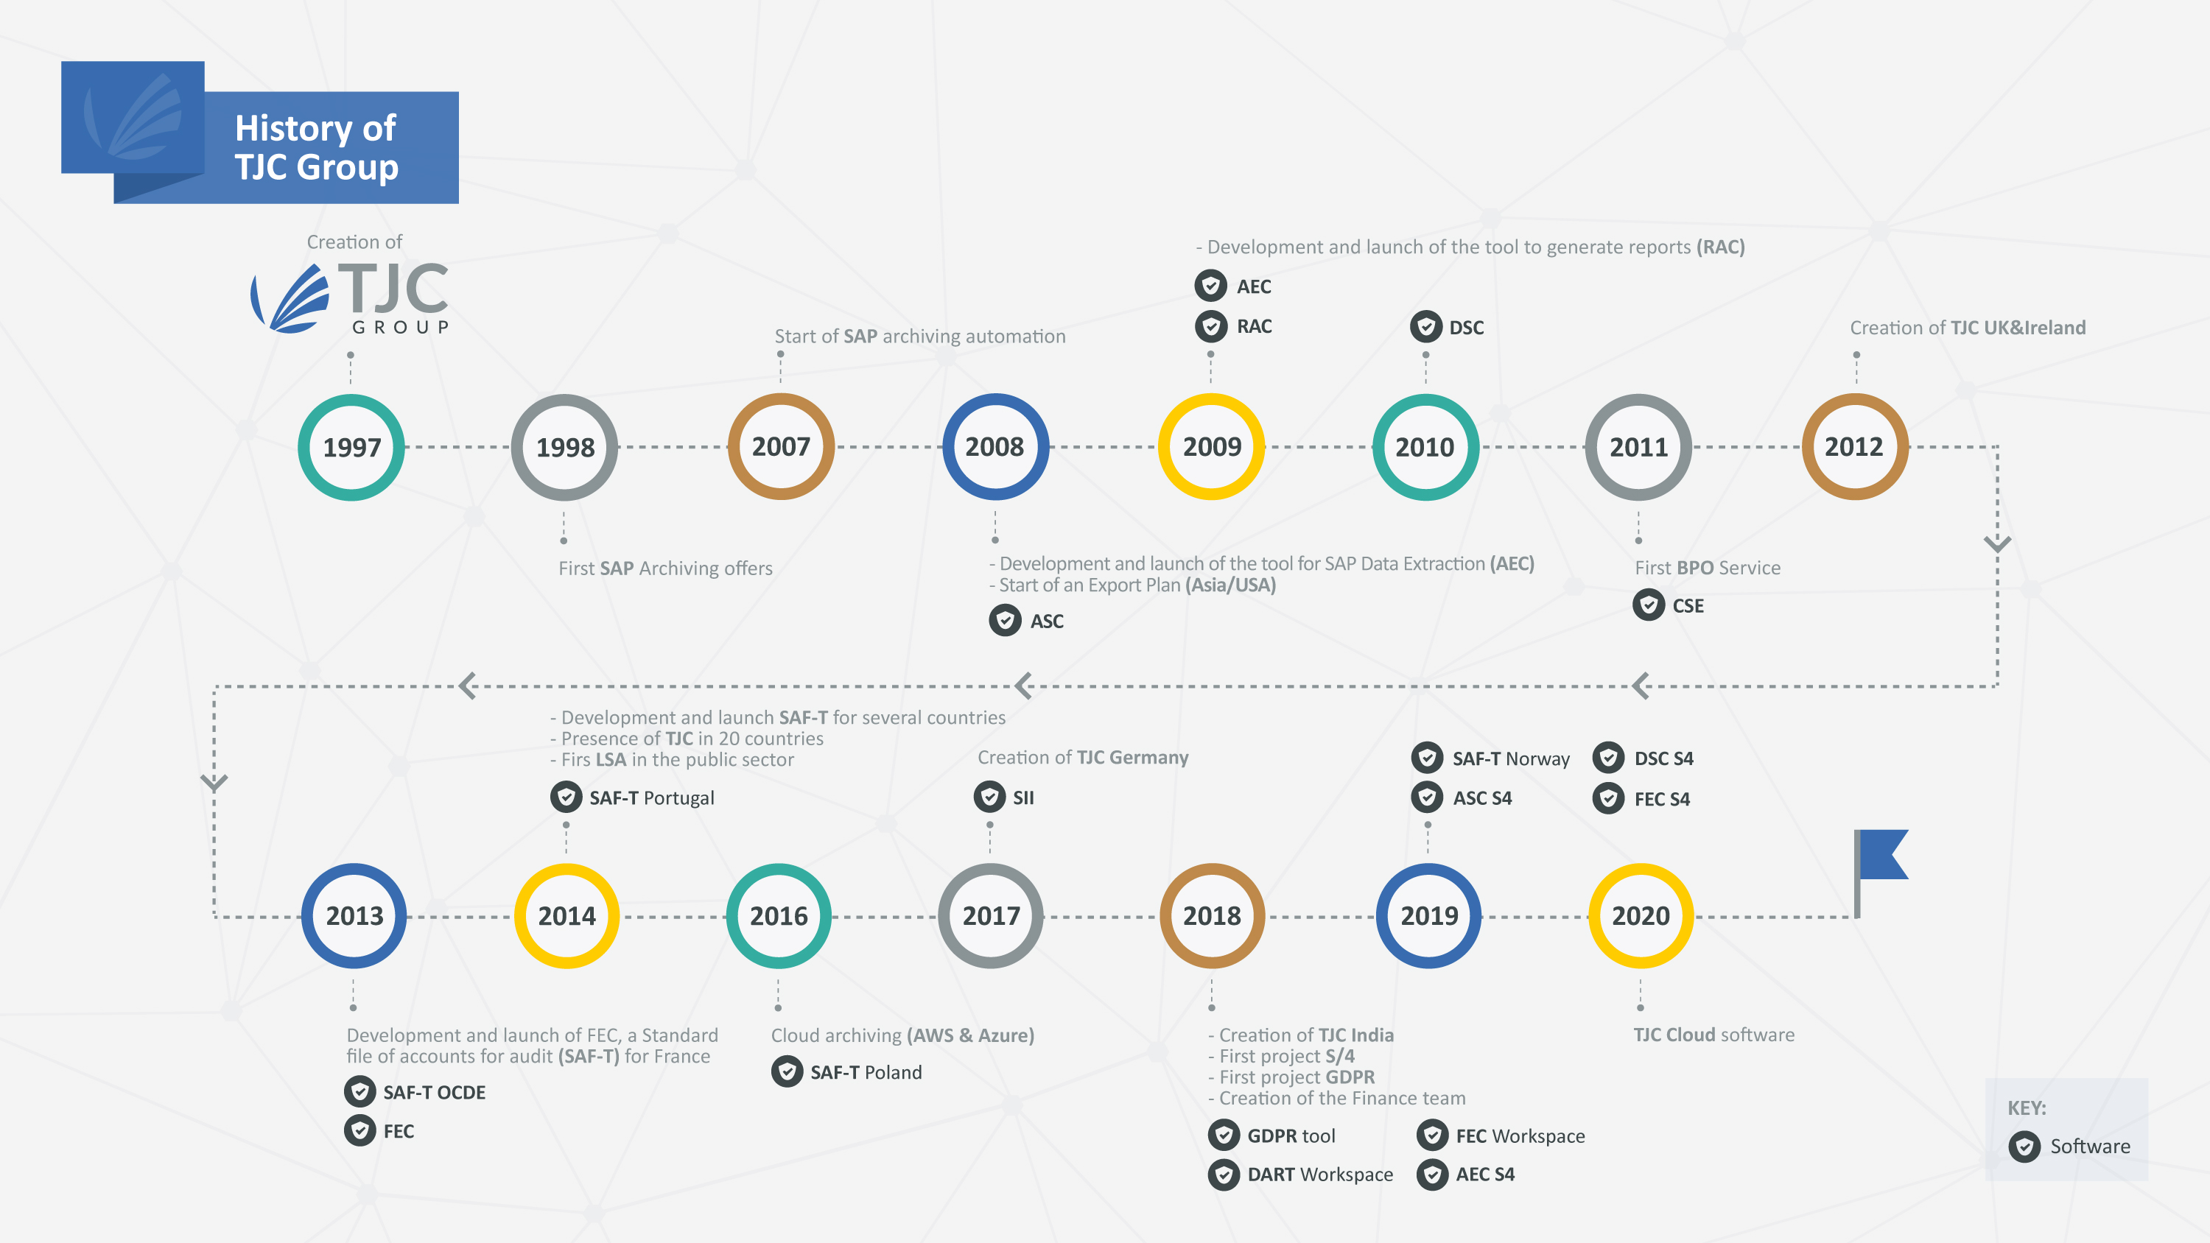

Slide 4
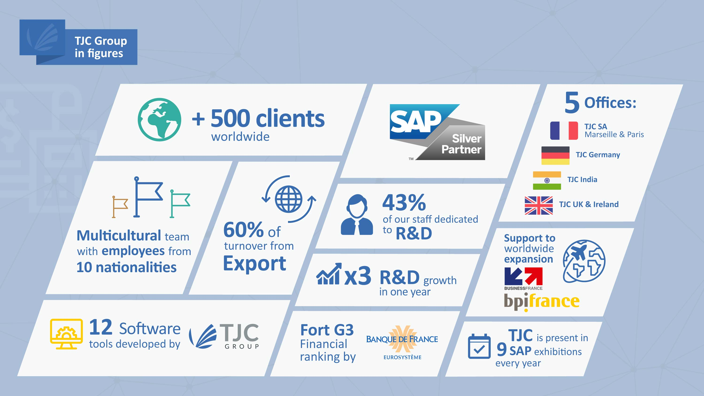

Slide 5
Focus
Why Archiving/Decommissioning saves: -

Slide 6
Focus
Why Archiving/Decommissioning saves: -
1/. MONEY

Slide 7
Focus
Why Archiving/Decommissioning saves: -
1/. MONEY
2/. TIME

Slide 8
Focus
Why Archiving/Decommissioning saves: -
1/. MONEY
2/. TIME
3/. RISK

Slide 9
Migration – Typical Options
1/. Greenfield – a new installation
2/. Brownfield – a mix of migrating data & new
3/. Conversion – total transformation from ECC to S4

Slide 10
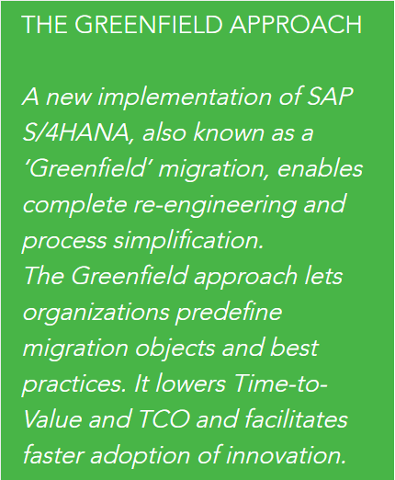
Greenfield Migration
An all-new implementation
New Processes
New System
Can ignore old processes
[SAP are saying this method is no longer being followed – too complex]

Slide 11
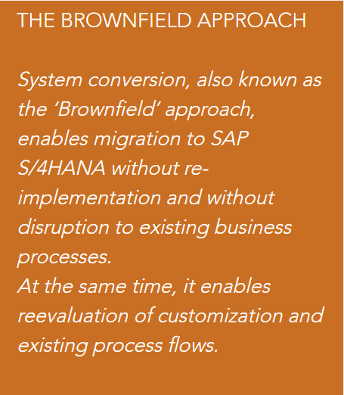
Brownfield Migration
Migrate the processes
Migrate some data
Makes best use of existing knowledge
Assumes what you have is best and maintains the previous investment[s]

Slide 12
Full Conversion Migration
THE ‘FULL’ CONVERSION APPROACH
The complete data and content is migrated from the existing environment to the new S4 landscape introducing new processes for the simplified modules.
Maintains the maximum existing processes and associated data and ensures future security that all data can be in place for future audits.
Probably the most expensive option
Removes risk from future compliancy needs
Limits the introduction of new processes into the new environment

Slide 13
Migration Typical Options
1/. Greenfield – a new installation
2/. Brownfield – a mix of migrating data & new
3/. Conversion – total transformation from ECC to S4
Each option can BENEFIT from archiving or decommissioning

Slide 14
Identify the savings
ARCHIVING:–
1/. Reduces Data Volume
a/. Saves on storage maintenance
b/. Saves on storage licensing
c/. Saves on storage administration
2/. Secures Data Integrity
a/. Logical file structure/naming convention
b/. Relevant data locked against time
3/. Enables Long-Term Retention
a/. Secure & Access-controlled
b/. Not readable, other than originating system

Slide 15
Reduces Data Volume – The Carlsberg Story
Redacted

Slide 16
Reduces Data Volume – The Carlsberg Story
Redacted

Slide 17
Reduces Data Volume – The Carlsberg Story
Redacted

Slide 18
Reduces Data Volume – The Carlsberg Story
Redacted

Slide 19
Reduces Data Volume – The Carlsberg Story
Redacted

Slide 20
Reduces Data Volume – The Carlsberg Story
Redacted

Slide 21
Identify the savings
DECOMMISSIONING:-
1/. Reduces Landscape costs
a/. Administration
b/. Licensing (ECC)
c/. Maintenance
2/. Reduces Backup/Restore times
3/. Reduces Eco/Power/Air-Con costs
4/. Removes infrastructure/Operating System costs

Slide 22
SIMPLE example [Not Complex]
An imaginary case: -
Client on ECC6 with 14TB – a standard relational DB; moving to S4/Hana
The move to HANA solution removes some meta-data and so reduces the data volume to +/- 9TB
Using SAP standard archiving tools then a reasonable estimation is +/- 5TB to migrate

Slide 23
SIMPLE example [Not Complex]
Imaginary case
Guideline on costs – using a CLOUD supplier for S4 environment
  Moving +/- 9TB on to CLOUD = 301,001€ /annum

Slide 24
SIMPLE example [Not Complex]
Imaginary case
Guideline on costs – using a CLOUD supplier for S4 environment
  Moving +/- 9TB on to CLOUD = 301,001€/annum
  But moving only +/- 5TB on to CLOUD =
173,321€/annum

Slide 25
SIMPLE example [Not Complex]
Imaginary case
Guideline on costs – using a CLOUD supplier for S4 environment
Annual saving on this example
127,680€

Slide 26
SIMPLE example [Not Complex]
Imaginary case
Guideline on costs – using a CLOUD supplier for S4 environment
Based on that annual saving on this example 127,680€,
that’s 638,400€ over 5 years

Slide 27
SIMPLE example [Not Complex]
Imaginary case
Guideline on costs – using a CLOUD supplier for S4 environment
Based on that annual saving on this example 127,680€,
that’s 638,400€ over 5 years.
JUST BY PLANNING & ARCHIVING

Slide 28
The BIG Comfort Factors
S4 can read all archive files from ECC
Data retention is secure and archive files are “unreadable”.
GDPR retention/destruction can be improved by using archive files
Tax/Compliance/Regulation – easier - 100% of data available to respond

Slide 29
The BIG Comfort Factors
S4 can read all archive files from ECC
Data retention is secure and archive files are “unreadable”.
GDPR retention/destruction can be improved by using archive files
Tax/Compliance/Regulation – easier - 100% of data available to respond

Slide 30
S4 Memory Usage
Typical memory block runs +/- 50/50 with data and available space for processing

Slide 31
S4 Ageing
Cold Data Hot Data
Aged [cold] data is meant to move to disk

Slide 32
S4 Memory Usage
Normal running after Aged data was moved to disk

Slide 33
Tax Audit ???
Cold Data
Aged data is returned to memory
The returning cold data impacts on processing ‘space’.

Slide 34
Running Performance
With less available memory for processing – response slower

Slide 35
S4 Memory can read Archive files
Archive Files
Reads Direct

Slide 36
S4 Memory can read Archive files
With Ageing not delivering at this time – then archiving S4 from the very early start up is important as the best way to manage data volumes and optimisation of HANA memory.
Archive Files
Reads Direct

Slide 37
The BIG Comfort Factors
S4 can read all archive files from ECC
Data retention is secure and archive files are “unreadable”.
GDPR retention/destruction can be improved by using archive files
Tax/Compliance/Regulation – easier - 100% of data available to respond

Slide 38
Retention
Archiving data can be monitored and controlled – access and authorities can be applied - Safe
Archive files cannot be read externally – Viewing has to be via the originating systems – Secure
Archive files created in ECC can be migrated to S4 and configured to be securely read – Future Proofing

Slide 39
The BIG Comfort Factors
S4 can read all archive files from ECC
Data retention is secure and archive files are “unreadable”.
GDPR retention/destruction can be improved by using archive files
Tax/Compliance/Regulation – easier - 100% of data available to respond

Slide 40
GDPR Compliance
Managing GDPR by using the ‘blocking’ methodology to be compliant:-
- Archive files themselves are not ‘readable’ – Safe
- Authority controls to access can be applied – Secure
- Retention/deletion for different periods can be managed – Future Proof

Slide 41
The BIG Comfort Factors
S4 can read all archive files from ECC
Data retention is secure and archive files are “unreadable”.
GDPR retention/destruction can be improved by using archive files
Tax/Compliance/Regulation – easier - 100% of data available to respond

Slide 42
Tax/Compliance/Regulation
Supports processes & ensures the business best practices are followed - Safe
Ensures data ‘as it was’ for future use/print/viewing - Secure
File naming conventions ensure recovery of correct data; Files are ‘per company’; ‘per plant’ or as selected - Future Proof

Slide 43
The BIG Comfort Factors
S4 can read all archive files from ECC
Data retention is secure and archive file are “unreadable”.
GDPR retention/destruction can be improved by using archive files
Tax/Compliance/Regulation – easier - 100% of data available to respond
SAFE – SECURE – FUTURE PROOF

Slide 44
….and now you are S4?
Do you data archive on S4?
Do you data age on S4?

Slide 45
….and now you are S4?
Do you data archive on S4?
Do you data age on S4?
Do you need to consider this now?

Slide 46
….and now you are S4?
Do you data archive on S4?
Do you data age on S4?
Do you need to consider this now?
or later?..............

Slide 47
….and now you are S4?
Do you data archive on S4?
Do you data age on S4?
Do you need to consider this now?
or later? .............. DO IT NOW

Slide 48
….and now you are S4?
Do you data archive on S4?
Do you data age on S4?
Do you need to consider this now?
or later? .............. DO IT NOW……..DO NOT WAIT!!!!!!

Slide 49
SUMMARY
Archiving has long been on the ‘to do’ agenda.
Priority has not been given to the practice.

Slide 50
SUMMARY
Archiving has long been on the ‘to do’ agenda.
Priority has not been given to the practice.
It has traditionally cost money and taken a long period to gain the ROI.

Slide 51
SUMMARY
Archiving has long been on the ‘to do’ agenda.
Priority has not been given to the practice.
It has traditionally cost money and taken a long period to gain the ROI.
The move to S4 and removal of ECC is a major opportunity to make positive early and LARGE savings and gains – leaving the new environment in a good place for best practices with secure data for the future.

Slide 53



contact@tjc-group.com
https://twitter.com/tjcsoftware
https://www.linkedin.com/companies/tjc-group
https://www.youtube.com/user/tjcgroup

