Slide 1
Live Hacking – SAP system under attack!
Ernest Gutierrez Roca | October 24, 2019

Slide 2



Who is Onapsis?
Buenos Aires
Boston
Heidelberg
300+ employees
250 customers
55 partners
500+ SAP & Oracle Vulnerabilities
Reported
2
Notes:
Founded: 2009 in Buenos Aires, Argentina
Moved HQ to Boston, MA, in 2012
Introduced Onapsis Security Platform to the market in Fall 2014
Announced intention to acquire Virtual Forge in January 2019
300+ employees worldwide – US, Argentina, Germany
Most comprehensive platform protecting ERP systems
250+ customers, including many Global 2000 organizations
More than 200 SAP security advisories and presentations published
Go-to-market relationships with strategic partners: IBM, Verizon, Deloitte

Slide 3
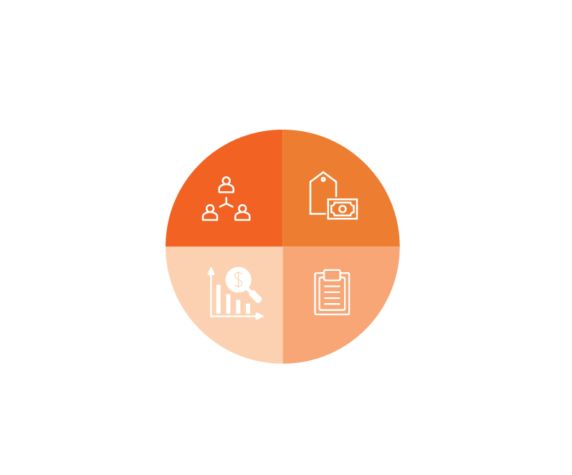
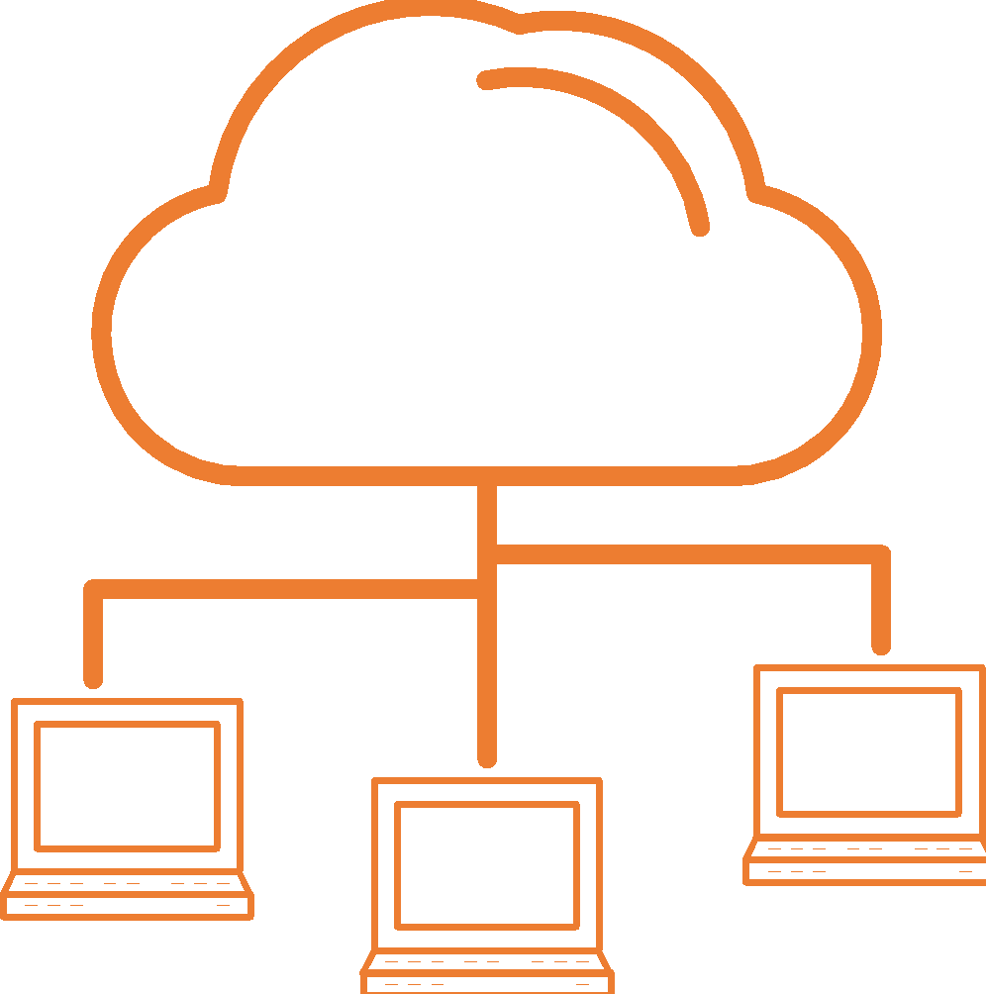


ERP Systems at Risk - Now More than Ever
ATTACKS
ARE INCREASING
ATTACKS SURFACES
ARE GROWING
YOUR MOST IMPORTANT
DATA IS BEING TARGETED
64% of organizations’ ERP systems have been breached in the past 2 years.
74% of organizations’ ERP applications are accessible via the web.
Attackers primarily target 4 types of ERP data: HR, Sales, Financial and Customer Information.
Data based on an IDC survey of decision makers from organizations that have Oracle EBS or SAP installed.

Slide 4
Fragility of Security in SAP
Authorizations are not enough to secure our SAP System
  Missconfigurations (10KBlaze)
  Wrong parameters/settings (many to take care of all sometimes and security are usually the last as they could impact GoLive)
Firewalls does not prevent internal attacks
  We usually have externals working on our systems
  Disappointed employee
Compliance against many regulations
  What if I do not comply to my internal security policies? Nothing
  What if I do not comply to governamental/stock regulations? Fines/Bad Reputation

Slide 5
10KBlaze History
2007 – Attacking the Giants: Exploiting SAP Internals by Mariano Nuñez (Onapsis CEO)
2010 – Rootkits and Trojans on your SAP Landscape by Ertunga Arsal
2012 – Remote Function Call: Gateway Hacking and Defense by SAP
2019 – Gateway to Heaven by Dmitry Chastuhin and Mathieu Geli

Slide 6

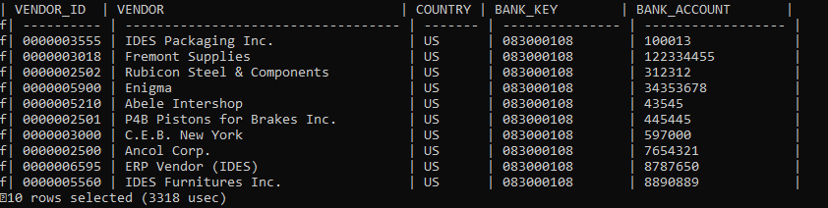
Hacking an SAP using 10KBlaze missconfiguration
Accessing SAP system at OS as sidadm
Get 10 Top vendors
…

Slide 7
Sarbanes-Oxley Act of 2002
Section 404 mandates that all publicly-traded companies must establish internal controls and procedures for financial reporting and must document, test and maintain those controls and procedures to ensure their effectiveness.
Section 409 states that organizations that are subject to SOX are required to disclose to the public, on an urgent basis, information on material changes in their financial condition or operations

Slide 8
Material Weakness
A material weakness is a deficiency or combination of deficiencies in internal control, such that there is a reasonable possibility that a material misstatement of the entity’s financial statements will not be prevented or detected and corrected on a timely basis.
Could we consider what we saw a Material Weakness?

Slide 9
Q&A

Slide 10
Thank You

