Slide 1
SAP and Usability Thinking
Exploring user-centered design principles in enterprise software solutions
Presented by
A
Anastasia Parramore, Aker BP
Helge Torsøy, Aker BP
Jennifer Ståhlberg, Vivicta
H
J

Slide 2
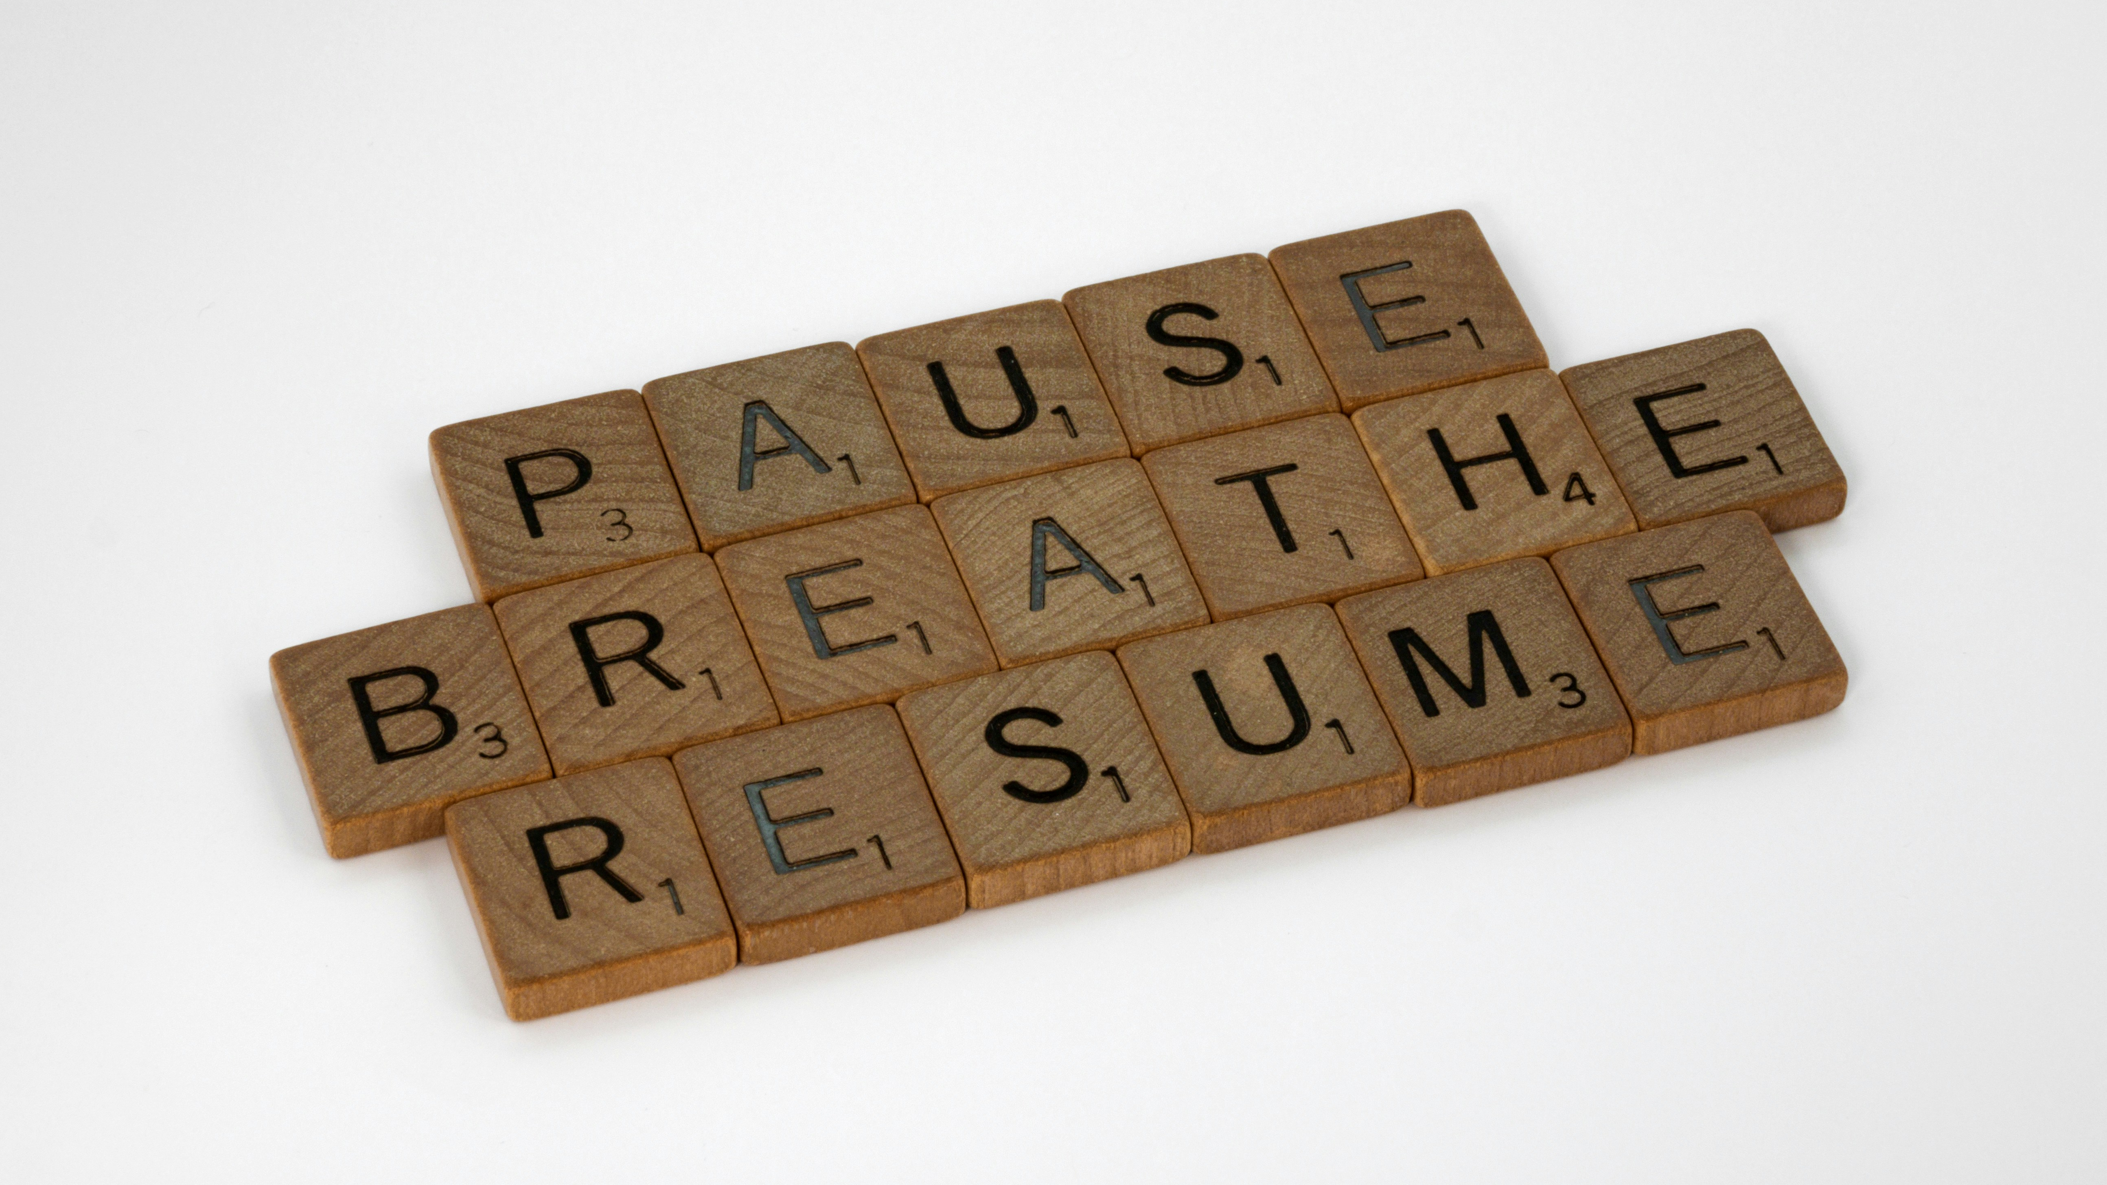
Notes:
Before we start, I want to ask you to do something a little unusual with me .
When I go into an important meeting, I do a quick holding breath exercise that I really love. We are moving towards the end of the day and this exercise helps me to freshen up and to focus better, I hope it will help you too.
Let’s do this together. And you guys (Jennifer & Helge) please join us as well.
Take a deep breath in, hold for a second, breath out and hold.
How do you feel? Do you feel a little more present?
That little exercise, that little pause helps to reset our focus.
In UX, everything starts with a pause. It’s when we stop for a moment, listen, and try to understand what is going on before we start creating solutions.
This little exercise is very easy to forget or to neglect, but when I do it, I'm much more prepared for my meetings. Design Process is very easy to forget, but it actually creates huge benefits when done correctly and that is what we will talk about today. Over to you Helge!

Slide 3
Our Goals for Today – Why This Matters
👂Design for People – Not Just Processes
🧠Design as a Mindset – Not a Phase
🚀Design That Creates Value – Quietly
Notes:
Why is this important? Why are we here today?
Turning complexity into clarity — and systems into something people actually love to use.
Option 1
1. Design for People – Not Just Processes → Understand how empathy, trust, and user insight drive adoption and real business value. Punchline: Good UX starts with listening, not coding.
2. Design as a Mindset – Not a Phase → Explore how creativity, iteration, and collaboration between business and IT lead to better outcomes. Punchline: UX isn’t what happens at the end — it’s how we work from the start.
3. Design That Creates Value – Quietly → See how intuitive design saves time, reduces friction, and lets users focus on decisions, not systems. Punchline: The best UX is invisible — it just works.
Option 2 - Preferred
Understand the balance of soft and hard skills in UX → Great design is not just about tools and competence; it’s about empathy, listening, and creating psychological safety for users and teams.
See design as both a mindset and a process → By approaching problems with creativity, iteration, and user-first thinking, we can consistently move towards better solutions.
Recognize the value good design creates → Well-executed UX not only improves adoption and satisfaction, but also saves money by reducing friction and staying “invisible” when done right.

Slide 4
Our Journey Ahead
UX Theory
The Forecast App Story
Design Thinking in Practice
User Impact & Feedback
Looking Back, Moving Forward
Usability Thinking in the SAP Context
From Idea to Launch
Facilitating Creativity and Collaboration
Measuring Value Through User Voices
Reflection, Discussion, and Q&A

Slide 5
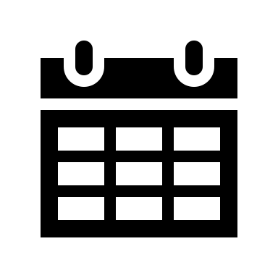





Nielsen’s heuristics
SAP Fiori design guidelines
1994
Introduced over a decade ago!
Visibility of system status
Match between system and real world
User control and freedom
Consistency
Error prevention
Recognition, not recall
Flexibility & efficiency of use
Aesthetic and minimalistic design
Help recover from errors
Help and documentation
Role-based
Adaptive
Coherent
Simple
Delightful
Notes:
Term HCI intorduced since 70’s
Usability problems in UI design
90’s vs today tech
SAP understanding the mission: 5 guidelines
familiar to all
Have we really lived up to the hype?
SAP set the bar low
Standard design framework, also tools and guidelines to follow
In standard apps the principles are there. Not everyone...
So far seen design guidelines ignored, think about design phase – includes end users?
Let's look for a moment why its worth INVESTING in good UX.

Slide 6
Bad UX vs Good UX
Poor user engagement
Better user adoption
😖
🙂
More mistakes
Better data quality
🚫
🔍
High training costs
Intuitive flow
💸
💡
Changes at late stage
Less iterations
⏳
⚡
🐢
Higher efficiency
Slow processes
🚀
Notes:
USER ENGAGEMENT
Always change resistance
Majority open to positive changes
MISTAKES
If possible, will happen
Reduce errors by design
More support ticket
TRAINING
SAP transaction –30 buttons
How many training hours?
When flow is intuitive, no need to LEARN steps and validations,
reduce memoryload, excessive training
CHANGES
Can have a heavy impact
Without a proper design, you are taking the risk
that even though on paper you at both sides of the table agree on how something
should behave,
you end up totally disagreeing when you see the end result.
Without proper visualization unable to evaluate all scenarios needed
With good documentations,
less iterations in build
SLOW PROCESSES
Hudreds Daily iterations, matters how many clicks and seconds something takes.
Reducing time spent in the app we can speed up processes and efficiency
Despite all of these reasns UX is still discarded.
And I was thinking why and for what reason.

Slide 7






Reasons UX design phase is discarded
Schedule
Responsibility
Budget
Not knowing the cost of bad UX
Process centered culture
Lack of resources
Notes:
SCHEDULE
It might seem faster on paper to get started with technical design
UX thinking takes time upfront, as it starts with workshopping and evaluation.
But the truth is — when you skip early discovery and workshopping,
you end up paying for it later in rework, confusion, and user resistance.
BUDGETING
Time is money
Designers are seen as an easy item to cut,
because the value isn’t always immediate or measurable.
PROCESS
Huge machinery
SAP has a long history in GUI being process oriented
RESPONSIBILITY
Business, IT, ext partners, buyer
Lacking clear ownership > Prioritization left undone
COST
Not something to put in a budget
RESOURCES
New role hard to sell internally
And being a new area to explore, I want to give a few steps how you can get started.

Slide 8





How?
Get a UX Designer from Day 1
Shift from Process to Usability Thinking
Visualize First
Have End Users Approve the Design
Fill in the Technical Gaps
Start with user experience expertise from the beginning of the project
Focus on user needs and behaviors rather than internal processes
Create visual representation before diving into detailed specifications
Validate designs directly with your target users before implementation
Bridge the space between design vision and technical implementation
Notes:
Knows the users need
Necessary items / reduce complex flow
Components, context, importance of coherence
Look at it different
2. Steve Jobs
"You've gotta start with the customer experience and work backwards to the technology".
Start design before technical details
3. We have a bunch of tools that you can use to make mockups, prototypes
No longer a vague item in the future
100% clear goal
AI tools
4. See the flow
Look and feel
Usability testing
You understood the process and the need
5. Maybe 3rd party integrations
In stead of focusing on the limitations think big and explore the solution!

Slide 9


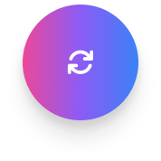

Development process
Framing the problem
Discovery & co-design
1
2
Prototyping & UX principles
3
Notes:
We started by framing the problem — not the solution. The goal wasn’t just to replace Excel; it was to make forecasting easier, faster, and more trustworthy.
We asked: ‘What do our users actually need?’
Stakeholder interviews
Process mapping
Problem statement
Business value – User needs vs business objective value -> Prioritization
2. From there, we mapped out roles and responsibilities — who does what, when, and why — because forecasting in exploration isn’t just one person typing numbers. It’s collaboration across licenses, partners, and timing.
From day one, we brought controllers and end users into the room. Not just to tell us what didn’t work — but to shape what could.
User journey
Personas
Design thinking and Co-design workshops
3. We replaced complex specifications with sketches and simple wireframes, which made it safe to react — because nothing looked finished.
Prototypes
Iterative refinement
Design guidelines
That’s how we moved from assumptions to insights — and from ideas on paper to something people were excited to use.”

Slide 10
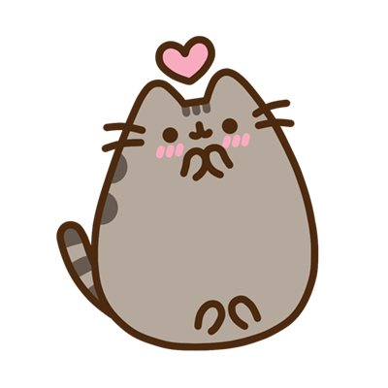





Empathy & Safety = Better ideas
"Psychological safety"
Encourage open feedback
Ask "silly" questions
Learn to listen
Humour lowers pressure
Notes:
Helge talked about the development process and during this process we had maaany meetings. We realized that it is important that these meetings go well and this is why I want to talk about psychological safety. It is important not just in faciliating design process, but in any work process.
So, what is psychological safety exactly and why is it important? It’s when people feel safe to speak up, share ideas, and make mistakes and they are not afraid to be judged or to look stupid.
Research says that when people share ideas and concerns freely, ask questions, well it feels good, but it also boosts honest feedback, creative solutions, innovation, learning and growth....the list of benefits is endless. Just imagine if users dont tell us what they really think or need or if developers are scared to ask questions, the solution will naturally be bad.
Therefore, the first goal shouldn’t be to get ideas, but to make people feel safe.
How did we do it?
We highlighted that we want our app to be intuitive and bug free, so users should not hesitate to share even smallest concerns about the app. Sometimes people can be scared to say that they don't understand something in the app because it might underestimate their intelligence, therefore we found out that it was important to emphasize that we really appreciate as much feedback as possible and that if users don’t understand something then it is not their intellegence, but the app hasn’t achieved its full potential yet and we need their help to get there. This removes fear of looking silly and encourages more feedback.
We realized that espessially in the beginning of the project, when many things are unclear it is important to ask many questions and often they migth seem silly. It is impornat step on you ego and ask anyway, yes it is not easy, but you have to do it anyway and it gets easier with time. It is a way to model vulnerability and also in design process it is very important for everyone to understand the process and what we are trying to achieve. So repeating the same things in different words is important to make sure everyone understands and is on the same page.
And maybe the most important thing. It is to really listen. How do we really listen? It is good to repeat what people say but in your own way and to ask if you understood correctly. Like a waiter at a restaurant repeats what you want to eat after you make an order. We need to take into consideration that people can struggle to express certain things. Repeating what they say helps and asking more questions like "please tell me more", "can you please show me what you mean". It signals curiocity instead of pressure and give people space to open up.
4) and last point – humor. Humor is a medicine. We joked in this project and that really lowered pressure in the room. People laughed, relaxed, and suddenly they started talking more freely. Humor helps for creativity to rise. Thus try to have fun!

Slide 11
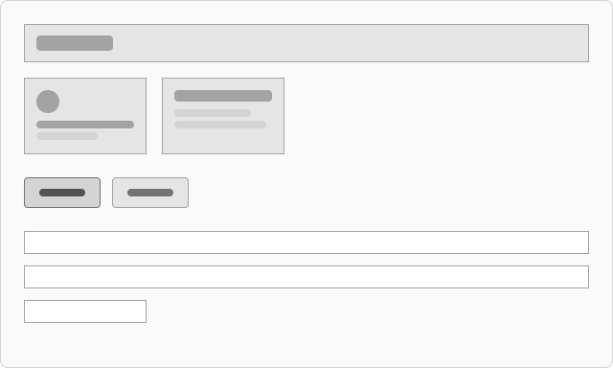





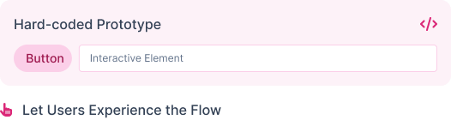


Mockups invite Co-Creation
Low-fidelity mockups
Testing options
Borrow ideas
A
B
C
User reactions & feedback
Study existing patterns
Interactive Demo
Pen and paper sketches
Balsamiq wireframes
Notes:
Let’s talk about mockups. And just to make sure we’re all on the same page, when I say mockup, I mean a simple draft of the app.
It is a good practice to begin with low fidelity mockups, and by that I mean very rough mockups – so ideally just pan and paper. There are apps or websites that can be used to imitate pan and paper. For example Balsamic is a nice tool that I like to use. When you show rough mockups, it is very easy to comment on them, because users see that you didn’t put much effort into it. It is much harder to criticize something when you see that a person spent a lot of time doing it. In the beginning of our project we highlighted that everything that users see in the mockup is easy to change and doesn’t have to be this way, and that we are showing them mockup just to start a conversation, this way users are encouraged to give feedback. You can do the same in your projects.
As you progressed with mockups and also when you start making some hardcoded high fidelity mockups, and by high fidelity I mean something clickable and looking more similar to end result add several options on the screen of the same functionality, to show opportunities and to let users choose what they like best. Is is good to encourage to think of a new option, which could be a combination of all proposed options or something very new. When people see only one solution, they naturally evaluate it, "Do I like it or not?" And it triggers a sense of performace. "I need to give a rigth answer". This limits creativity. When they see multiple options, the brains moves from evaluation to comparison and exploration. There are no right answers, people feel more autonomous, like they are making choices and not being tested. This activates creativity and self-expression.
2) In this project we borrowed ideas from other SAP apps and already developed previously apps, so that our solutions feel familiar and coherent. It follows the design principle Jennifer talked about earlier, that all apps should have consistent functionality and feel like one unified system. Thus we show other apps with similar functionality to what we need and we evaluate together if it is something that we can use. Reusing already developed functionality also speeds up developent process. As a developer I love when we can reuse something on build on on something excisting.
3) Before starting development it is good to show a high fidelity mockup to the users, you can just hardcode everything in the app, so it has a look and feel of a finished app, but functionality is still missing. Then let users test it a bit and give comments. In our project we continued showing results during whole development process and adjust small things together.

Slide 12
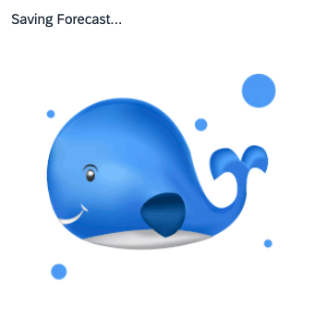

PLAY
Notes:
Now we are moving towards my last point. You guys seem like funny people, so this migth not apply to you, but in general People often think that the more serious they are the better resutls they will get. But it is wrong.
Don't forget to PLAY! Children learn and create through play, they feel safe when they play and while playing they unlock their creativity. And we are the same. When we play we feel safe, therefore when we allow a bit of playfulness in our work, we stay curious, creative, and open and create most simple intuitive and innovative solutions to complex problems.
So give all your crazy ideas and maybe one of them will become a geniuos solution.
On the screen you see a small easter egg from the app that we added, for fun. Saving forecast migth take a long time, so we wanted to entertain people while they wait and show them this whale after they click "save forecast"

Slide 13

Notes:
Alright, time for a quick neuro wake-up!
We’ve been listening and thinking for quite a while, and the brain starts drifting when we sit too long. So, let’s do a short tapping exercise that re-activates our body and focus”
“Let’s start by tapping with your fingertips on back side of your hand, then your chest.
This 30-second reset that increases blood flow and literally wakes up your nervous system.
While we do it I will tell you a fun fact: seeing a cute animal actually triggers oxytocin — the hormone of connection and trust.
UX work, and learning new thing as what you're doing now, both depend on staying present and connected. So next time your brain zones out in a long meeting, just tap and think of your favorite baby animal.
Great UX is like watching this little seal, you feel happy and calm.

Slide 14
Impact & User Feedback
I still miss some of Excel’s flexibility — it let me adjust things on the fly.
It’s so much easier to use than the old system
I actually enjoy doing my forecasts now
It sometimes feels like there’s a bit too much scrolling
What felt intuitive at first didn’t always feel that way after a few months away
Validations that guide, not block
Notes:
+ Thought bubbles with semantic colors (red, green, blue)
Coming from users who’d spent years buried in spreadsheets, ‘easier’ didn’t just mean fewer clicks — it meant fewer doubts. They no longer had to wonder if they were in the right version. Edits were centralized — no more emailing files around.
Nobody used to say that before. What changed was visibility. With mass editing, instant feedback — they can adjust, test, and understand impact right away. Forecasting stopped feeling like paperwork and started feeling like insight. Also, the whale. And that’s when we knew the design was working — when users said they enjoyed it.
“One of the biggest pain points in Excel was inconsistency — the same cost item could have five different names, depending on who updated the file or which license they worked on. In the Fiori app, we standardized naming, rules, structure, logic, and hierarchy - across licenses and cost types. That consistency means less confusion, better data quality, and easier consolidation. Everyone now speaks the same financial language — and that alone saves hours of rework.
” In Excel, if something was off, you only found out later — or worse, during consolidation. In older systems, validation rules could be harsh: red errors that stopped everything.
Users stay in control, and the system becomes a coach instead of a gatekeeper. That builds trust — and trust drives adoption
-
This was a recurring theme. Excel, for all its chaos, gave users a sense of control — they could tweak and move things instantly. What we learned is that flexibility itself is a kind of comfort zone. Our challenge was to keep that feeling of control, but within a structured, reliable system
It’s such a simple comment, but it reveals how design decisions, like grouping or layout, directly affect usability. Less movement = more focus
This was maybe the most important insight. It reminded us that intuitive design isn’t about what users learn — it’s about what they remember. When users return after time away and hesitate, it means something that seemed clear was actually just familiar.

Slide 15
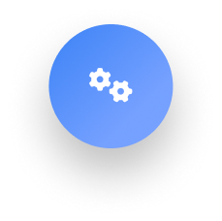
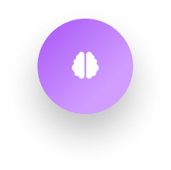

Key takeaways
Good UX requires soft and hard skills
Understanding users, empathy and psychological safety are as important as design competence
Design is a mindset and a process​
Creativity, iteration and user-fist thinking lead to better results
Design creates value​
Good design saves money, drives adoption and stays invisible
Notes:
Design for People: Great UX requires more than tech skills. Empathize with your users – listen to them. Soft skills (empathy, communication, trust) are just as critical as software skills.
UX is a Journey: Good design is an iterative mindset, not a one-off task. Embrace prototyping, testing, and refining. By approaching problems with creativity and user-first thinking, you consistently land on better solutions.
Good UX = Real Value: Investing in usability pays off. When design is done right, the software feels intuitive (almost “invisible”), which boosts adoption and efficiency. In enterprise terms, that means happier users, fewer errors, and even cost savings from less re-training and support.
In the end, the best compliment for a well-designed app is that no one talks about it – because it just works.

Slide 16
Q&A
What is on your mind?
Notes:
We like to pick Jennifers brain

Slide 17



Thank You!
Anastasia Parramore
SAP UX Developer
MORE AS
LinkedIn
Helge Torsøy
Senior Digital Finance Analyst
Aker BP ASA
LinkedIn
Jennifer Ståhlberg
Senior SAP UX Consultant
Vivicta
LinkedIn

